Slide 1
Comp 7081
Technical Issues in Software Development
Bruce Link
Notes:
Introduce self
Go around the room to have everyone introduce themselves

Slide 2
Instructor
Bruce Link
Ph.D. Computer Science, 1976
5 years experience in US research laboratory
18 years experience at MacDonald Dettwiler
  Project Engineer, Project Manager, Engineering Manager
Led Projects in excess of 350,000 Lines
Program Head Information Systems, BCIT

Slide 3
Text
Software Engineering
A Practitioner’s Approach
Fifth Edition
Author - Roger S. Pressman
McGraw-Hill, 2001

Slide 4
Format
12 3-3/4 hour classes
1 15-minute break per class
Lecture plus discussion
Class participation encouraged
3 assignments + final

Slide 5
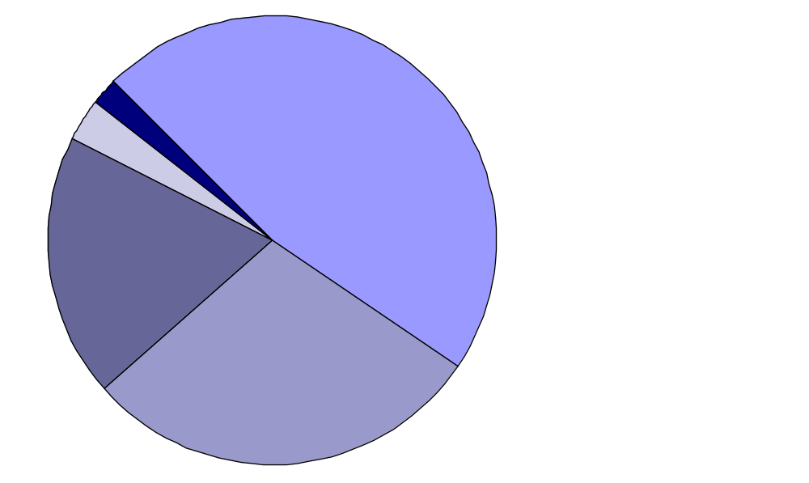
Results:
U.S. Army Software Projects
2% Used as delivered
47%
Delivered but
never used
3%
Used after
change
19%
Abandoned
or reworked
29%
Paid for but
not delivered
Notes:
Why do we think this is?
Is this typical of software projects?
What about large ones?

Slide 6

Industrial View
Why does it take so long to finish a working software system?
Why are development costs so high?
Why can't we find all software errors before software is delivered?
How can we measure the progress of software development?
How can we survive in the global economy?
Notes:
1. Early software development was considered to be an "art form"
2. Formal methods did not exist or were not followed
3. Programming education mainly by trial and error
4. Example of problems: Operating System for the IBM 360 (data extracted from The Mythical Man-Month by Fredrick Brooks, Addison-Wesley, 1975)
● large software product (almost 1 million lines of code)
● as errors were fixed, more errors were produced
● adding people to the project made things worse
● few formal methods of design were known or used
● project was abandoned and the operating system was completely rewritten
● project had a major impact on producing formal methods in software engineering

Slide 7
Problems
1. We have little data on the software development process.
2. Customers are often dissatisfied with the software they get.
3. Software quality is hard to define and measure.
4. Existing software is often very difficult to maintain.
Can these problems be
overcome?
Notes:
Historically, measurements of software development were not done, so we did not gather any data from past experiences to use in predicting the schedules and costs of future projects.
Customer needs were usually understood only vaguely. Consequently, programs often fell short of the customers' desires.
A solid quantification of the metrics associated with the software does not exist, so it becomes difficult to predict software quality.
Maintenance has become the most expensive, difficult, and poorly planned task of the entire software life cycle.

Slide 8
Why is Software
Development Difficult?
Communication
Complexity
Newness of the activity
Nature of software

Slide 9
Communication
Within organization
Customer/developer
Problems
  natural language
  user desires are vague
  computer jargon
Example:
  “Display reverts to that which was shown immediately prior to last command entry”
Notes:
Example: customer thought the command would be retracted, not just the display reverted. Resolving this took several days of 5 people’s time and an additional 6 man-weeks of additional effort

Slide 10
Complexity
Size of things attempted
  communication paths become n² problem
Attempting problems which are more complex
Modularization tries to help
  languages add higher level features
  subprograms, classes, packages

Slide 11
Newness of the Activity
Civil Engineering
  6000 years?
Mechanical Engineering
  300 years
Electrical Engineering
  100 years
Software Engineering
  25-30 years

Slide 12
Nature of Software
Non-material
Ethereal
Flexible
Pliable
Both strengths and weakness

Slide 13
Software Characteristics
Software is programs, documents, and data
Software is developed or engineered; it is not manufactured like hardware
Software does not wear out, but it does deteriorate
Most software is custom-built, rather than being assembled from existing components
Notes:
1.Many people have the non-engineering view of software:
as computer programs (i.e., source code and/or executables),
as data structures (e.g., data base schemas), and
as operation and user documentation (usually created as an afterthought when the "real" work is done)
2.A major factor in the speed at which quality software is developed is the failure to reuse software:
there are few reusable component libraries,
there is a bias against using "old" routines or routines "not invented here", and
software as a creative art is a perception that is held by many people.
3.Software has become a business opportunity, where the success or failure of a business (and the jobs of the people associated with it) depends upon the timely development of quality software. The customer is demanding both high quality in the software (and once a business has a reputation of putting out "junk", word gets around quickly) and timeliness of delivery (the customer wants the software now ).

Slide 14
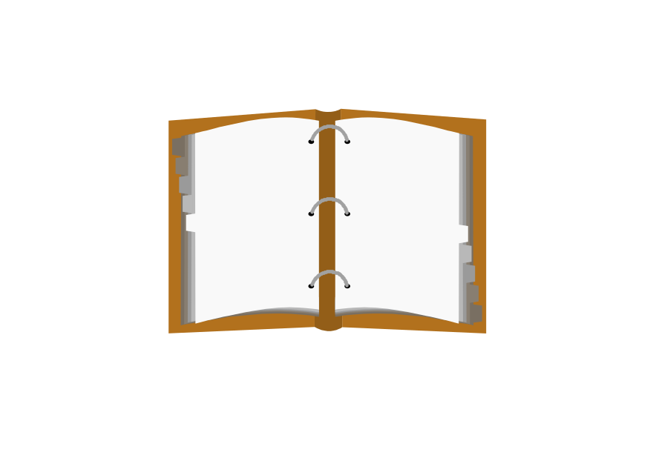
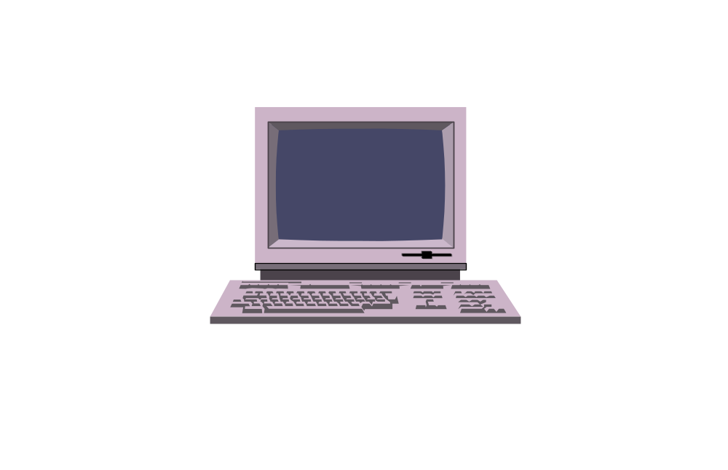
Software Configuration
Software
Project
Plan
Software
Requirements
Specification
Software
Design
User
Documents
Data
Structures
and
Dictionary
Code
Software
Test Plan and
Procedures
Notes:
Composition of Software
The software we develop is composed of these parts, also known as software configuration items:
Software Project Plan - A document which details the tasks, schedules, needed resources, and approach to carry out development. This is the first document produced and it includes cost details.
Software Requirements Specification - A document which identifies what is required of the software (as opposed to the design document, which describes how to implement the software). This document includes information on how implementation of the requirements will be verified (i.e., some initial test considerations). This very important document is often quite time consuming to produce.
Software Test Plan and Procedures - A document which describes the test methods, approaches, procedures, and the support required for testing the software code components and the integrated software system. This document includes test data and expected results and is developed during both the requirements definition and design phases of the project.
Data Structures and Dictionary - The Data Dictionary documents all data structures and the definitions of terms, variables, and other items of interest regarding the details of the data in the system. It supports software design, coding, and maintenance and is developed during the requirements and design phases.
Software Design Document - A document which clearly details the behavior and structure of the system as a whole and each software code component.
User Documents - These are user guides, reference guides, application notes, and other items deemed necessary for the users.
Code - The compilable source code of the system.

Slide 15
Failure Curves for
Hardware and Software
"Infant
Mortality"
"Wear
Out"
Change
Failure
Rate
Actual
Ideal
Time
Time
FAILURE CURVE
FOR HARDWARE
FAILURE CURVE
FOR SOFTWARE
Notes:
Hardware tends to have a wear-in time during which it has a higher probability of failure. This is generally referred to as infant mortality. Once the initial period is passed, hardware tends to operate without failure until components age enough to cause breakdown.
Moral
Don't buy extended warranty contracts.
Standard warranty is usually long enough to pass through the infant mortality period.
Software also shows an early error rate, but updates should remove the most obvious problems which render the software unreliable. Updates for added functionality often add more errors, as is shown by the spikes on the failure curve for software. As updates are made, more latent errors appear in the software to make it inherently less reliable until the software is finally considered unreliable enough to stop using the software product or to perform a major redesign and rewrite of the software.

Slide 16
Objectives of
Software Engineering
To produce software
  within constraints of cost and time
  meeting quality criteria
    performance
    ease of use
    ease of maintenance
To achieve development objectives consistently and predictably

Slide 17
Customer Myths
Myth
A general statement of objectives is enough to get going. Fill in the details later.
Project requirements continually change, but change can be easily accommodated because software is flexible.
Reality
Poor up-front definition of the requirements is THE major cause of poor and late software.
Cost of the change to software in order to fix an error increases dramatically in later phases of the life of the software.
Cost
to
Change
1x
1.5-6x
60-100x
Definition
Development
Maintenance

Slide 18
Developer Myths
Myth
Once a program is written and works, the developer's job is done.
Until a program is running, there is no way to assess its quality.
The only deliverable for a successful project is a working program.
Reality
50%-70% of the effort expended on a program occurs after it is delivered to the customer.
Software reviews can be more effective in finding errors than testing for certain classes of errors.
A software configuration includes documentation, regeneration files, test input data, and test results data.

Slide 19
Management Myths
Myth
Books of standards exist in-house so software will be developed satisfactorily
Computers and software tools that are available in-house are sufficient
We can always add more programmers if the project gets behind
Reality
Books may exist, but they are usually not up to date and not used
CASE tools are needed but are not usually obtained or used
"Adding people to a late software project makes it later" -- Brooks

Slide 20
SOFTWARE ENGINEERING LIFECYCLES
Waterfall
Prototyping Model
Fourth Generation Techniques

Slide 21
Software Development Activities
Planning Activity
  Software Project Plan
Requirements Definition Activity
  Software Requirements Specification
  Software Test Plan and Procedures
  Data Structures and Dictionary
  User Documents
Design Activity
  Software Design Documents
  Software Test Plan and Procedures
  Data Structures and Dictionary
Coding and Testing Activity
  Code
  Software Test Plan and Procedures
Delivery and Maintenance Activity
  User Documents
  Others as needed
Notes:
When are the Software Configuration Items Produced?
The Software Configuration Items are drafted, reviewed, revised, etc., at many points throughout the activities performed during the development of the software. Seldom is a Software Configuration Item felt to be completely finished.
All Software Configuration Items are placed under configuration control, allowing for them to be changed and all changes to them to be tracked. Any particular version of any of the configuration items may be recreated when desired.
The control of the Software Configuration Items extends from the planning stages of the project through the maintenance activities -- the entire life of the software.

Slide 22
Waterfall Model
System
Engineering
Analysis
Design
Coding
Testing
Maintenance
Notes:
Classic "Waterfall" Model
This model is a systematic, sequential approach to software development. It is the oldest and most often used of all software engineering paradigms.
System Engineering - Establish requirements for the software as a part of the larger system. Determine which parts of the entire system are to be allocated to software.
Analysis - Establish requirements from the point of view of the software. Include functional, performance, and interface requirements for the software subsystem.
Design - Define the software architecture, procedural details, data structures, and interface characteristics for the software. The design process plans the implementation of the software to meet the requirements. Rapid prototyping and automated analysis of the design may come into play. The design of the software presents enough information so that a programmer who does not necessarily know how the system works can create code.
Coding - The translation of a design into a compilable form. If the design is sufficiently detailed and adequate technologies are available, coding may be automatic.
Testing - Analysis and verification that codes statements are fully compliant with the requirements and the customer's intent.
Maintenance - The process of continuing to support the system after it is released to the customer. This process often involves several types of activities:
Corrective Maintenance - fixing errors
Adaptive Maintenance - changing the software to run in different environments (such as new versions of an OS or new target platforms)
Enhancement - adding new features to the software

Slide 23
DOD-STD-2167A Life Cycle
System
System
Software
Preliminary
Detailed
Coding
CSC
CSCI
System
Req'ts
Design
Req'ts
Design
Design
& CSU
Integration
Testing
Integration
Analysis
Analysis
Tesing
& Testing
& Testing
System
Software
Prelim.
Software
Source
Software
Updated
Spec.
Req'ts
Software
Design
Code
Test
Source
Spec.
Design
Doc.
Descr.
Code
System/
Doc.
(Procs.)
Software
Segment
Interface
Interface
Test
Design
Req'ts
Prelim.
Design
Reports
Doc.
Spec.
Interface
Doc.
Design
Version
Software
Doc.
Software
Description
Development
Test
Doc.
Plan
Software
Descr.
Test Plan
(cases)
Software
Product
Spec.
SRR
SDR
SSR
PDR
CDR
TRR
FCA/PCA
Notes:
Review acronyms covered on next slides
SSR : System Requirements Review
SDR : System Design Review
SSR : Software Specification Review
CI : Configuration Item : An aggregation of hardware, software, or both that satisfies an end use function and is designated for separate configuration management by the acquirer.

Slide 24
Basic Terminology in DOD-STD-2167A
Computer Software Configuration Item (CSCI)
Computer Software Component (CSC)
Computer Software Unit (CSU)
Preliminary Design Review (PDR)
Critical Design Review (CDR)
Data Item Descriptor (DID)
Software Product Evaluation (SPE)
Formal Qualification Testing (FQT)
Configuration Management (CM)
Notes:
CSCI : “An aggregation of software that satisfies an end user function and is designed for separate configuration management by the acquirer. CSCIs are selected based on tradeoffs among software function, size, host or target computers, developer, support concept, plans for reuse, criticality, interface concerns, need to be separately documented and controlled, and other factors” - 498
CSC : “A distinct part of a CSCI. CSCs may be further decomposed into other CSCs and CSUs” - 2167A
CSU : “An element specified in the design of a CSC that is separately testable” - 2167A
Unit : An element in the design if a CSCI; for example, a major subdivision of a CSCI, a component of that subdivision, a class, object, module, function, routine, or database. Software units may occur at different levels of a hierarchy and may consist of other software units. Software units in the design may not have a 1-1 relationship with the code and data entities (routines, procedures, databases, data files, etc.) that implement them or with the computer files containing those entities.

Slide 25
Prototyping Model
Start
Stop
Requirements
Gathering and
Refinement
Engineer the
Product
Quick
Design
Refining the
Prototype
Building the
Prototype
Evaluation
of the
Prototype
Notes:
An Iterative Process
Requirements Gathering and Refinement - During the first loop around this circle, an initial statement of the requirements is obtained. During later loops, the requirements statement is revised based on customer feedback.
Quick Design - Very little time is usually spent on designing the prototype. Often, aided by workstation-based tools, we transition directly into building the prototype.
Building the Prototype - This often involves the aid of software tools.
Evaluation of the Prototype - The customer and the developers unite in their efforts to look at the prototype and determine its flaws.
Refining the Prototype - This step is taken only if the prototype is not discarded.
Engineer the Product - This step is taken when the customer and developer are completely satisfied.

Slide 26
Fourth Generation Techniques
Requirements
Gathering
"Design"
Strategy
Implementation
Using 4GL
Testing
Notes:
An Enhancement to the Classic "Waterfall"
First Pass
Requirements Gathering - Collection of requirements as before
"Design Strategy" - Design with 4th Generation Languages is often done online and is quite similar to coding
Implementation Using 4GL - Coding
Testing - Testing as before, with customer and developer evaluation
Iterations
Reenter the waterfall where required as indicated by the evaluation

Slide 27
Software Project Metrics
Measuring Software
Why Measure Software?
Two Types of Measurements
Categories of Metrics
Size-Oriented Metrics
Function Points
Function-Oriented Metrics
Measuring Software Quality
Relationship of LOC to FP
Use of Productivity Data

Slide 28
Measuring Software
Objectively measuring software is difficult
  Most projects use only "lines of code" (LOC) for metrics.
  Much disagreement exists on what and how much to measure
but
Accurately measuring software is vitally important to tracking and controlling software development
Same Project
Different Metrics
LOC
Statements

Slide 29
Why Measure Software?
To --
  1. identify quality of the software product
  2. assess productivity of the software developers
  3. assess benefits of using development processes and tools
  4. form a baseline for estimation
  5. justify requests for tools and training

Slide 30
Two Types of Measurements
Direct
-- cost
-- LOC
-- execution speed
-- binary code size
-- memory used
 easy to make
Indirect
-- functionality
-- quality
-- "-ilities"
not easy to make

Slide 31
Size-Oriented Metrics
Let KLOC = "thousand lines of code"
Then we can define
  productivity = KLOC / person-months
  quality = defects in code / KLOC
  cost = dollars / KLOC
  documentation = pages of documents / KLOC
Efforts and costs include all elements of software development (analysis, design, code, test, etc.).
Notes:
Don’t argue LOC here

Slide 32
Size-Oriented Metrics - Examples
Project Person- Cost KLOC Pages of Errors
Months Doc
A 24 $168,000 12.1 365 29
B 62 $440,000 27.2 1224 86
C 43 $314,000 20.2 1050 64
Project Productivity Quality Cost Documents
(KLOC/p-months) (errors/KLOC) ($/LOC) (pages/KLOC)
A 0.504 2.40 $13.88 30.17
B 0.439 3.55 $16.18 45.00
C 0.470 3.67 $15.54 51.98

Slide 33
Problems with Size-Oriented Metrics
Definition of "lines of code"
  Programming language dependent
  Penalize well-designed shorter programs
  Cannot easily accommodate non-procedural languages
  Difficult to assess LOC before a program is written
Only known errors can be counted
Types, skill levels, and productivity of personnel varies
Notes:
Discuss

Slide 34
Function Points
Attempts have been made to define an alternate size metric that makes more sense
Function points:
  language independent
  related to the volume of functionality
  easier to estimate from requirements descriptions.
Used as an alternative to lines of code in several commercial costing tools (e.g. SPQR, BYL)
Invented by A.J. Albrecht in 1979. Best documented in J.B. Dreger, Function Point Analysis

Slide 35
Function Points - Fi Values
0
1
2
3
4
No
Influence
Incidental
Moderate
Average
Significant
1. Does the system require reliable backup? 8. Are the master files updated on-line?
2. Are data communications required? 9. Are the inputs, outputs, files, or inquiries complex?
3. Are there distributed processing functions? 10. Is the internal processing complex?
4. Is performance critical? 11. Is the code designed to be reusable?
5. Will the system run in an existing environment? 12. Are conversion and installation included in design?
6. Does the system require on-line data entry? 13. Is the system designed for multiple installations in
7. Does the on-line data entry require the input different organizations?
transaction to be built over multiple screens 14. Is the application designed to facilitate change and
or operations? ease of use?
Notes:
Fi values are the complexity adjustment values used in the formula to weight the function points - see next slide

Slide 36
Function Points - Computation
Weighting Factor
Measurement Parameter Count Simple Average Complex Product
Number of user inputs x 3 4 6 =
Number of user outputs x 4 5 7 =
Number of user inquiries x 3 4 6 =
Number of files x 7 10 15 =
Number of external interfaces x 5 7 10 =
Count - Total
FP = count-total * (0.65 + 0.01ΣFi )

Slide 37
Problems with Function Points
1. These metrics are based on subjective data
2. Parameters can be difficult to obtain after-the-fact
3. Function Points have no direct physical meaning

Slide 38
Function-Oriented Metrics
Focus is on "functionality" or "utility"
Function Points support the derivation of potentially useful data for the comparison of one project to another:
  Productivity = FP / person-month
  Quality = defects / FP
  Cost = $ / FP
  Documentation = pages / FP

Slide 39
Relationship of LOC to FP
Approximate number of lines of code for one function point are:
  Language LOC/FP
  Assembly 300
  C 128
  COBOL 100
  Pascal 90
  C++ 53
  Java 53
  Ada 95 49
  Visual Basic 5 29
  Object-Oriented Languages 30
  Fourth Generation Languages 20
  Automatic Code Generators 15

Slide 40
Use of Software Productivity Data
Do not use LOC/person-month or FP/person-month to:
  Compare one group of developers to another
  Rate the performance of an individual
Many factors affect productivity:
  Approximate % Variation
  Factor in Productivity
  People (number, experience) 90%
  Problem (complexity, number of changes) 40%
  Process (language, CASE) 50%
  Product (reliability, environment) 140%
  Resources (CASE, hardware, software) 40%

